Slide 1
Design Specification - Flinder
Web Application Development, Team 3B

Slide 2
Flinder
The objective of our application is to assist students in their journey of finding their potential ideal flatmates. No one wants to spend their Uni life with someone they don’t get along with.
Flinder (Flat-tinder as name inspiration) will solve this issue by matching students according to preferences. Students will be able to sign up, list preferences and what they are searching for.
Sign-ups can be a singular student looking to join a group of students to move in together or may be a group of students looking to complete their current group with one or two extra flatmates.
Once signed up students are presented with an inter-active tinder based approach to swiping left or right according to their preferences with the ultimate end-goal of matching with an appropriate individual / group of individuals to move in with.

Slide 3
Requirements
User must be able to create and edit an account, cannot do anything without creation of account
User must able to customise their profile
User must be able to upload profile photos
Specify preferences
The website must present relevant users' profiles to the user
The user must be able to swipe left or right on a profile to approve or disapprove
Login with Google
The website should present matches to the user
If two users approve of each other then contact details can be shared

Slide 4
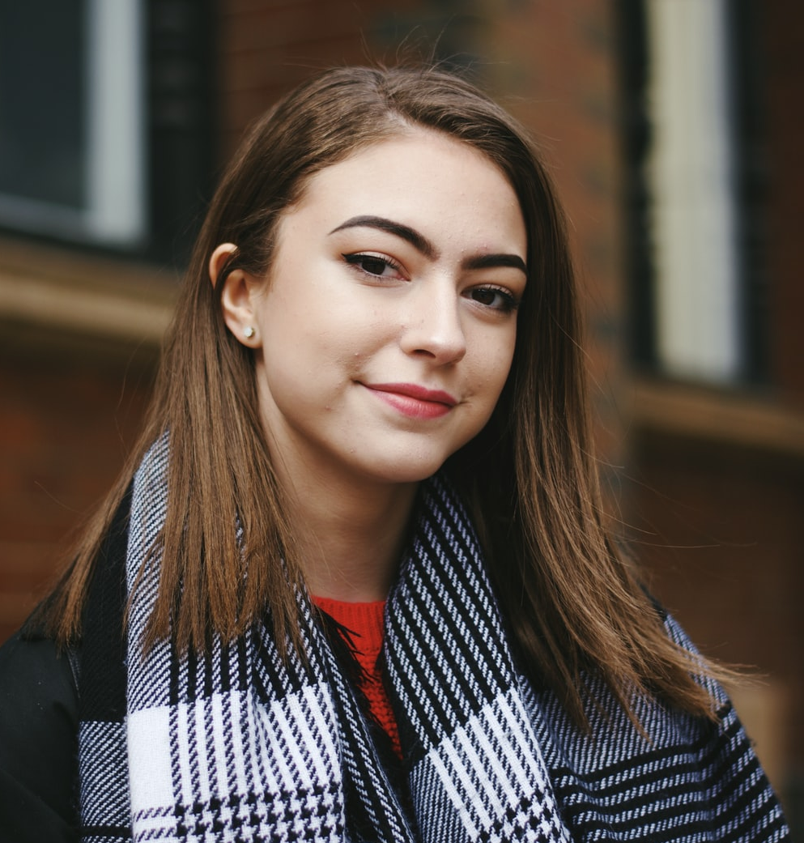
Persona 1: Niamh
Niamh is a 19 year old girl from Bear’s Den, Scotland about to go into her second year of Zoology at University of Glasgow. Because of the pandemic she spent her first year at home and did not make many friends over online classes. Niamh wishes to move to the West-End for her second year and is therefore looking for a potential group of people she could join to form a flat. She does not have any major preferences apart from wanting to move in with girls. Thus she would list all these specifications during the sign up process on FLINDER.

Slide 5
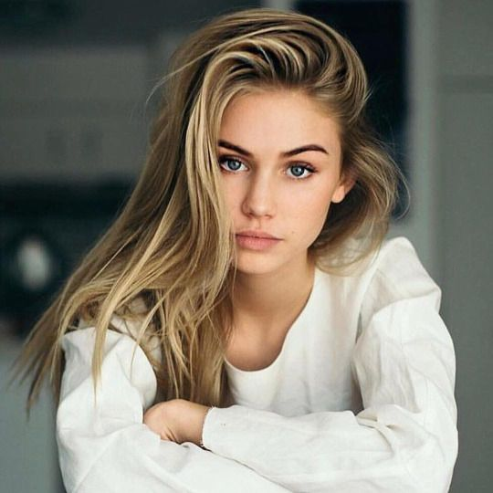
Persona 2: Nicole
Nicole is a 20 year old second-year international student from Paris studying Immunology at University of Glasgow. She stayed in the Uni accommodation Murano Student Village in first year and thus made a lot of friends. For second year she wishes to move in with her two Scottish friends Freya (19) and Tessa (19), however the group is looking for 1 or 2 more flatmates, preferably female, to make finding a flat in the West-End an easier chore. They are open to all types of people. Thus Nicole would list all these specifications during the sign-up process on FLINDER to find the perfect match to find the perfect matches.

Slide 6
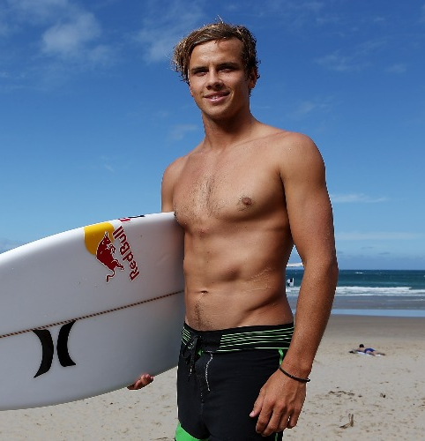
Persona 3: Adam
Adam is a 23 year old international exchange student coming to Glasgow from Australia. Adam is a third year Business Management student and is in desperate search for flatmates to move into a flat with him as he feels that all the university accommodation is overpriced. Being the laid-back Australian as he is, Adam does not really have any preferences regarding gender, age or studies. Thus he would list all these specifications during the sign up process on FLINDER to find the perfect matches.

Slide 7
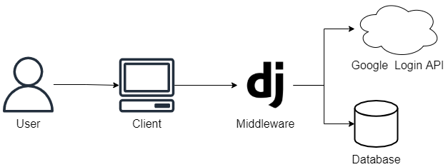
System Architecture Diagram

Slide 8
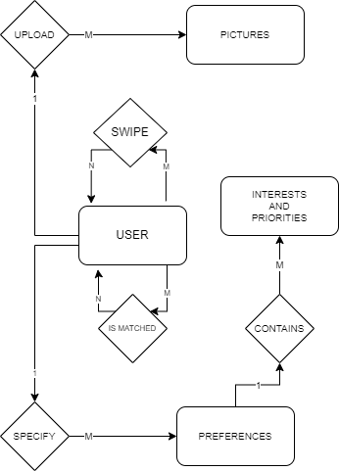
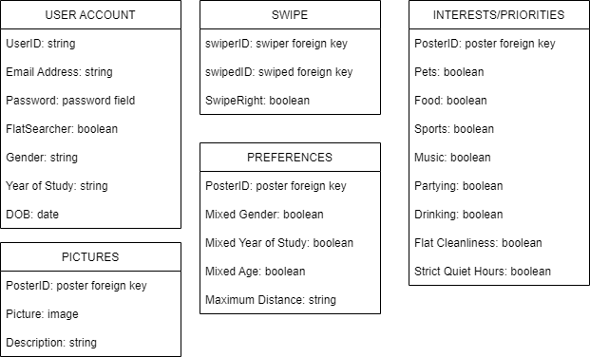
Entity Relationship Diagram (Compressed Chen Notation)

Slide 9

Wireframes

Slide 10


Email address:
person@example.com
Password:
********
Sign In

Slide 11
Create your account
Returns to registration page
Are you looking to find a room to stay in? Or are you looking for a flatmate to fill a room?
Looking for a room
Looking to fill a room
Button
Button
Field Label
Field text
Dropdown label
Dropdown option

Slide 12
Create your account
Looking to fill a room
Group Name
Address
Boyd Orr Squad
Address line 1
Birth year
Address line 2
Mixed
Post code
Postcode
Year of study
Mixed
Number of bedrooms
5
Gender
Mixed
Bedrooms available
2
University
University of Glasgow
Continue
Button
Button
Field Label
Field text
Dropdown label
Dropdown option

Slide 13
Tell us about your preferences
Gender
Mixed
Same
Year of study
Mixed
Same
Age
Mixed
Same
Maximum distance
2 km
Interests
(multiple selected)
Continue
Button
Button
Field Label
Field text
Dropdown label
Dropdown option

Slide 14



Upload photos
+
Continue
Button
Button
Field Label
Field text
Dropdown label
Dropdown option

Slide 15


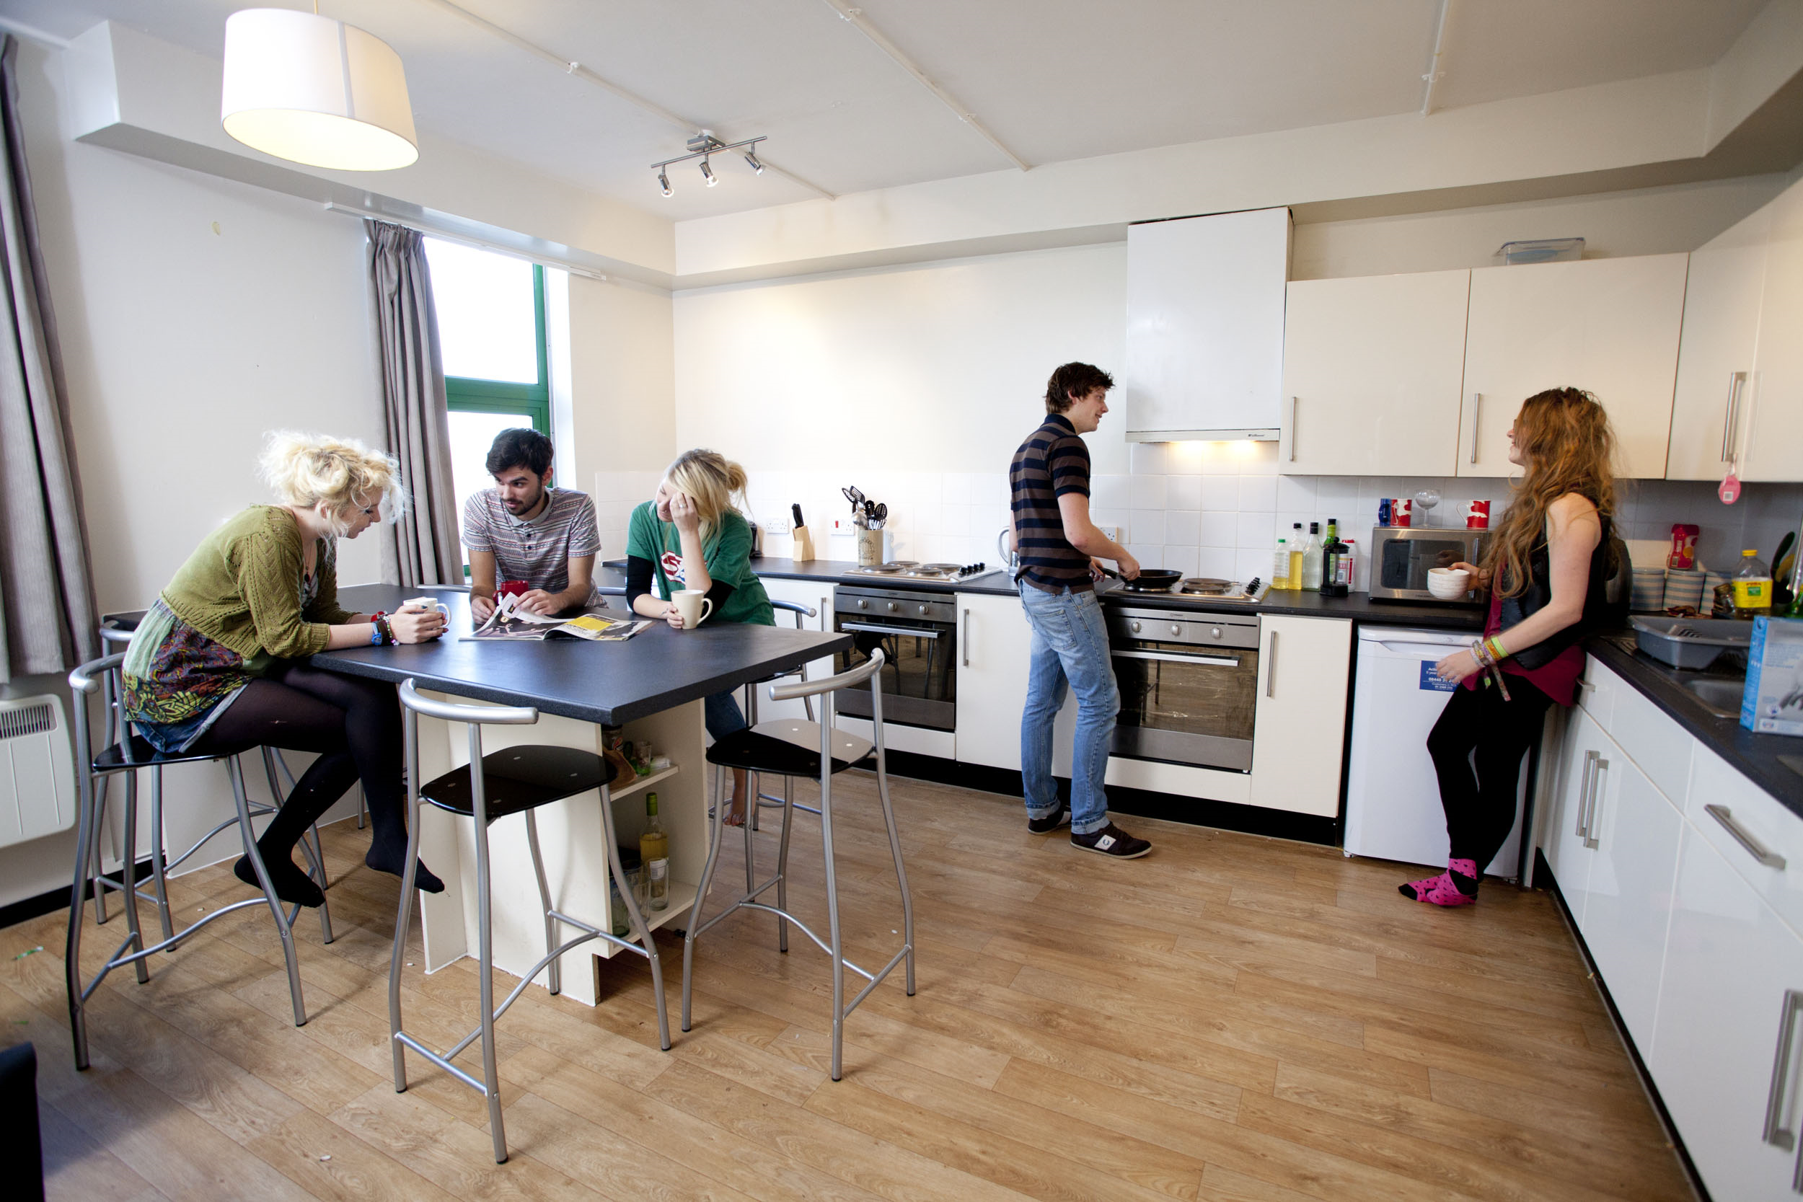
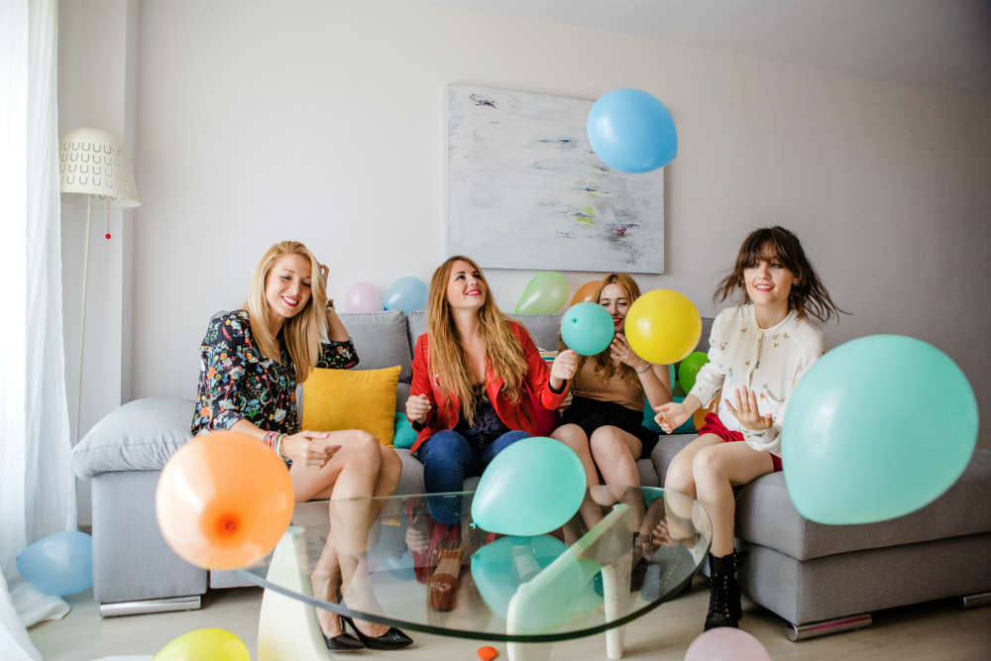

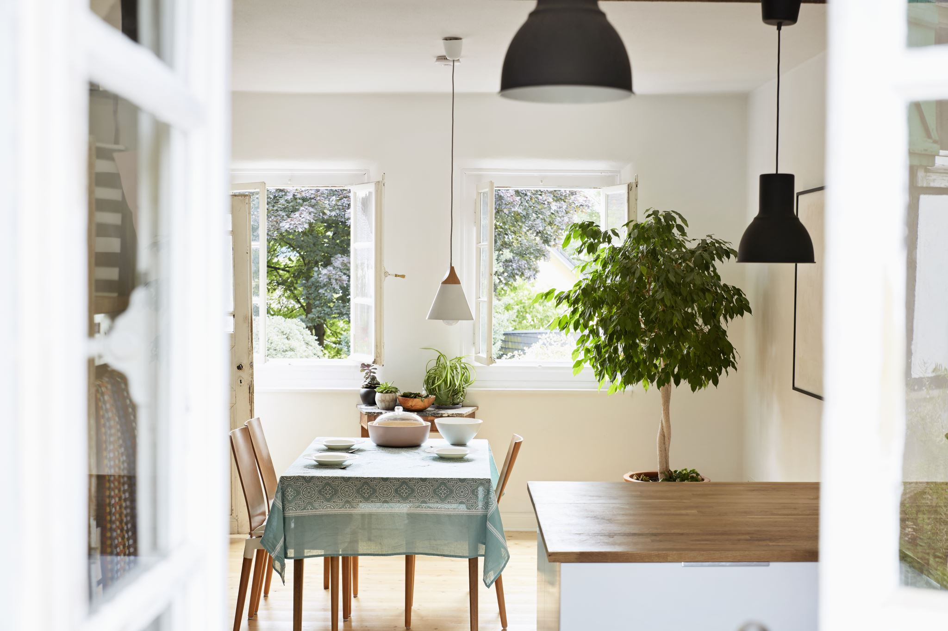

Opens profile page
Click to view the profile and get contact details
Opens matches page
Your matches
Knowles' Knook
Flat of 4 on Dumbartum Road
Southpark House
Flat of 3 on Southpark Avenue
Dislikes the current profile
Boyd Orr Gang
Flat of 5 on Byres Road
Likes the current profile
Button
Button
Field Label
Field text
Dropdown label
Dropdown option

Slide 16
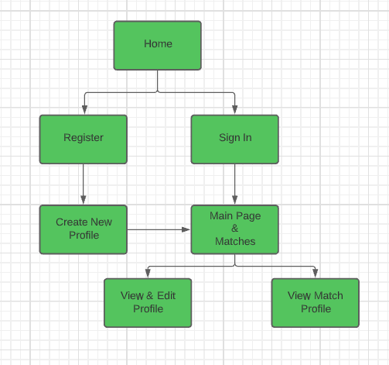
Site Map

